Slide 1
Secure Software Development
COMP6100001 - Software engineering
Session 17
Kenny Jingga, S.Kom., M.T.

Slide 2
Session 17 – Secure Software Development
Learning objectives
At the end of this session, students will be expected to be able to:
Understand the Importance of Security in Software Development
Identify Key Security Vulnerabilities and Secure Development Practices
Explore the Secure Software Development Life Cycle (SDLC) and Security Testing
Analyze Real-World Examples of Security Failures and Successes

Slide 3
Session 17 – Secure Software Development
Content outline
Importance of Security in Software Development
Secure Software Development Life Cycle (SDLC)
Common Security Vulnerabilities and Threats
Security Best Practices and Coding Standards
Implementing Security Testing in the Development Process
Tools for Secure Software Development
Case Studies on Security Failures and Successes

Slide 4
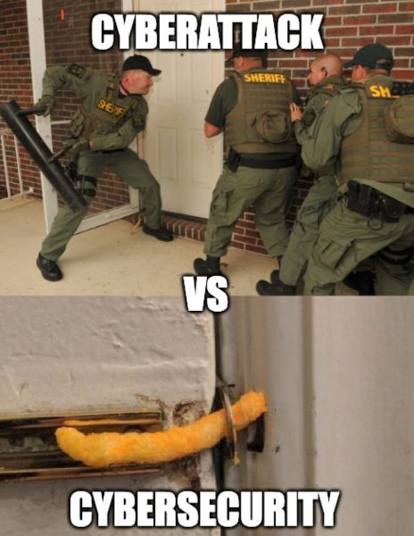
Security

Slide 5
Importance of Security in Software Development
Why?
Why Security Matters:
  Software security is essential to protect data, user privacy, and prevent breaches that could lead to financial loss and reputation damage.
  With increasing cyber threats, security must be a priority throughout the development lifecycle.

Slide 6
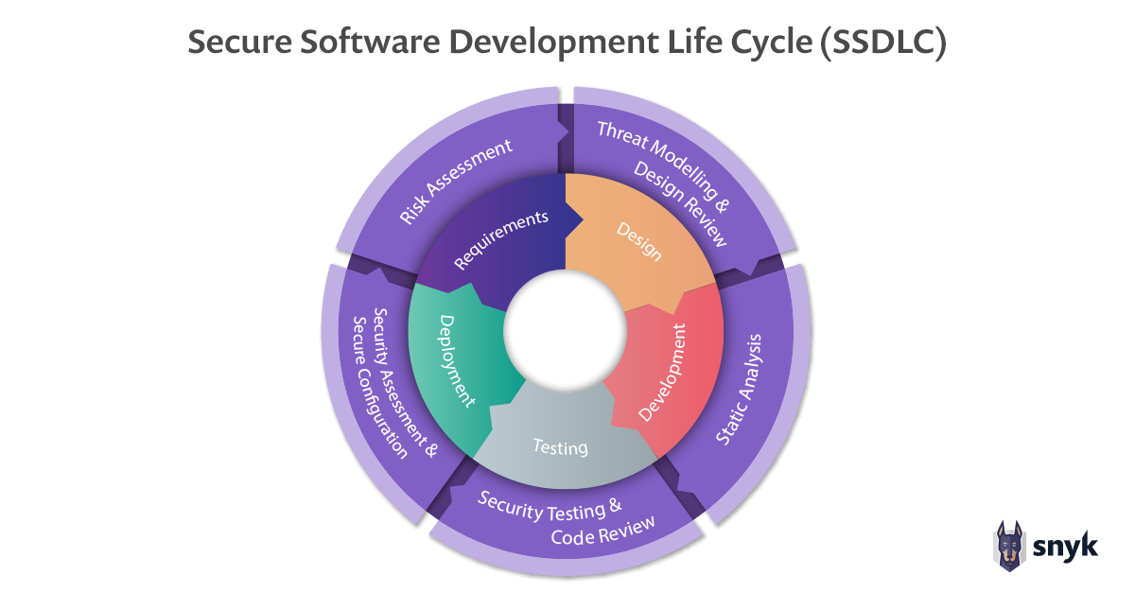
Secure Software Development Life Cycle (SDLC)
Overview
Secure SDLC integrates security practices into each phase of the traditional SDLC.
Phases include requirements gathering, design, coding, testing, deployment, and maintenance with a security focus.

Slide 7
Secure Software Development Life Cycle (SDLC)
Stages and Security Considerations
Requirements: Define security requirements based on threat models (Risk Assessment).
Design: Design for security with principles like least privilege and defense in depth (Threat Modeling & Design Review).
Coding: Use secure coding standards to prevent vulnerabilities (Static Analysis).
Testing: Conduct security testing alongside functional testing (Security Testing & Code Review).
Deployment: Secure configurations and access controls (Security Assessment & Secure Configuration).
Maintenance: Regularly update and patch software to address new threats.

Slide 8
Common Security Vulnerabilities and Threats
Attacking the Network
Examples:
  Person-in-the-middle attack
  Sniffing
  Spoofing
We must assume the network is not secure
We must guard against a compromised network

Slide 9
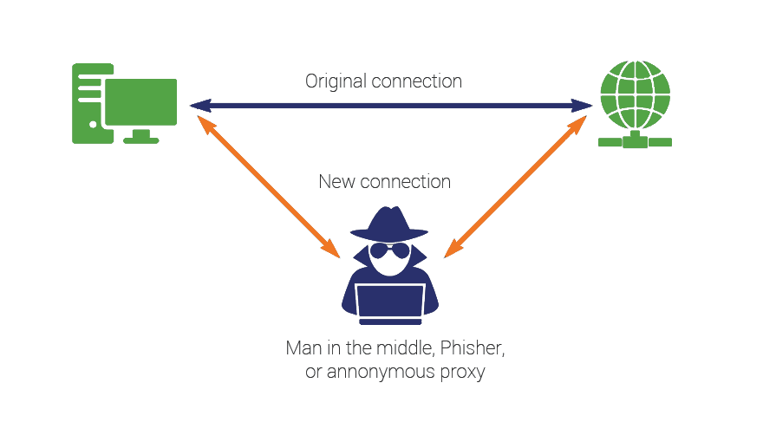
Common Security Vulnerabilities and Threats
Attacking the Network: Person-in-The-Middle
Someone that can intercept network traffic
Can read the messages (coming and going)
Can change the messages before sending them on (to the correct or incorrect destination)

Slide 10
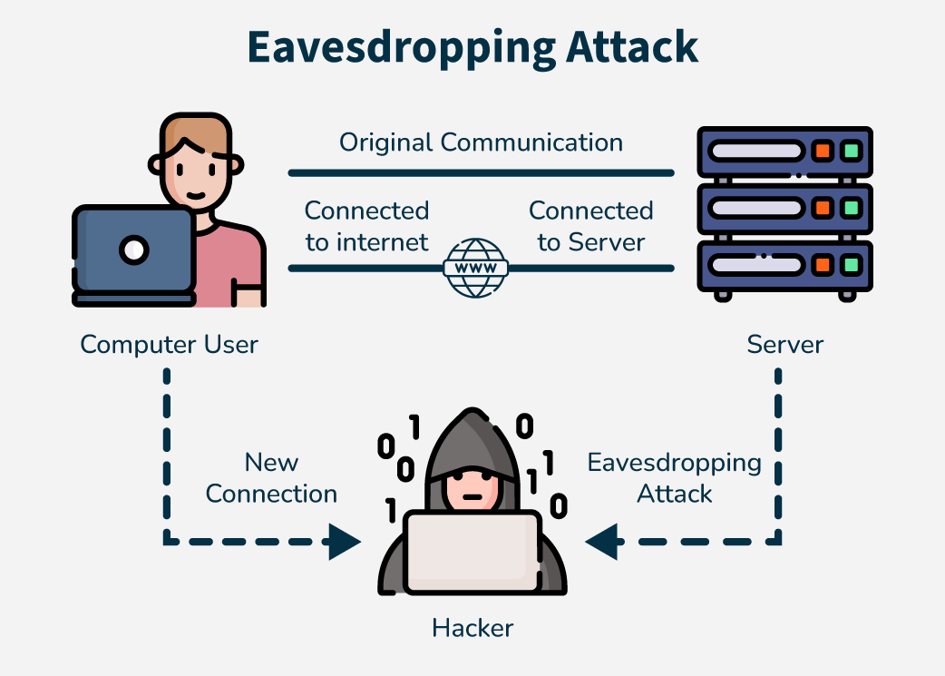
Common Security Vulnerabilities and Threats
Attacking the Network: Sniffing, eavesdropping, etc.
You can listen to the traffic going by on the net
This is typically traffic on your subnet
  Still it can be most interesting
  If you can plug in to the backbone…

Slide 11
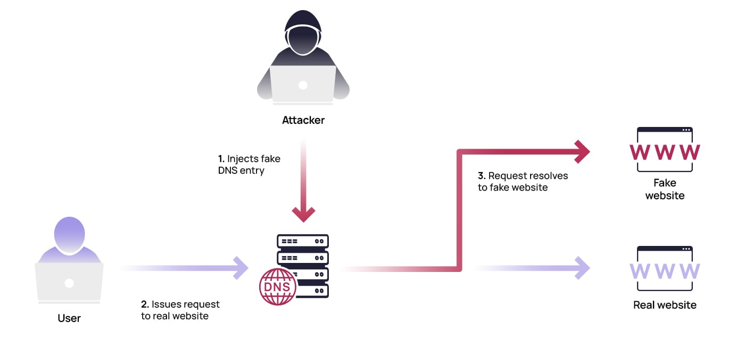
Common Security Vulnerabilities and Threats
Attacking the Network: Spoofing
Pretending to be someone you’re not
IP spoofing
  Pretending to a “client” you’re not (with a specific IP address)
E-mail Spoofing
DNS spoofing
  Pretending to be a server that you’re not
  Fool a DNS server to give out incorrect IP addresses for DNS Names
Note: also be careful of typos or similar characters attacks:
  http://mytimes.com
  http://paypa1.com

Slide 12
Common Security Vulnerabilities and Threats
Other Vulnerabilities and threats
Injection Attacks: Malicious code is injected, often via user input fields.
Broken Authentication: Weak authentication allows attackers to access unauthorized areas.
Cross-Site Scripting (XSS): Attackers inject scripts into web pages viewed by others.
Insecure Deserialization: Insecure handling of serialized data that can be exploited.
Insufficient Logging and Monitoring: Lacks detection of and response to breaches.
Insider Threats: Authorized users intentionally or unintentionally cause harm.
Social Engineering: Manipulating users to gain unauthorized access.
Advanced Persistent Threats (APTs): Continuous hacking processes targeting sensitive data.

Slide 13
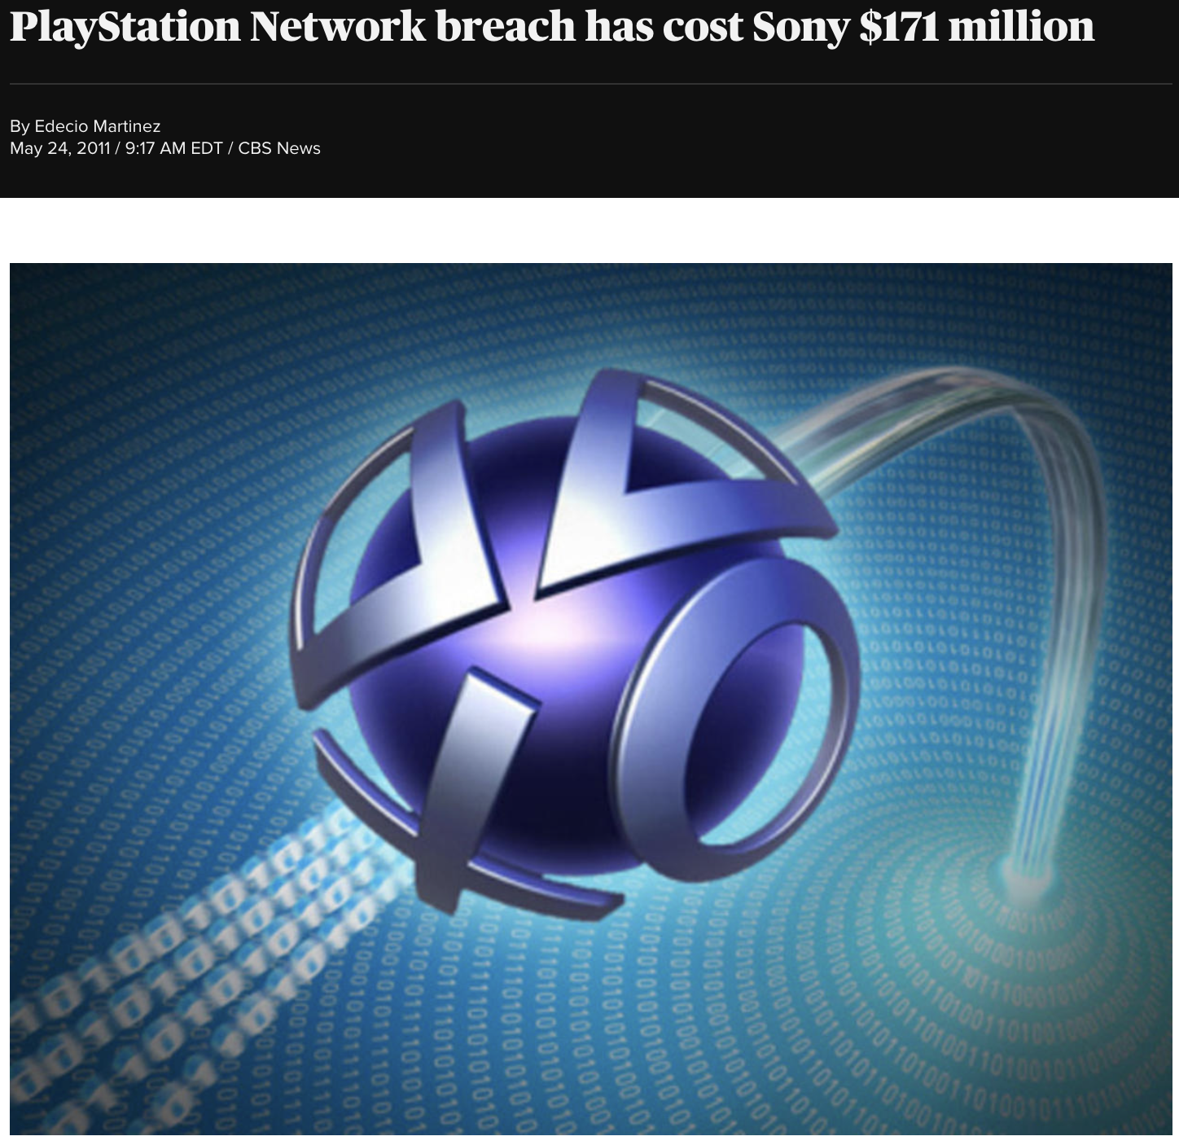
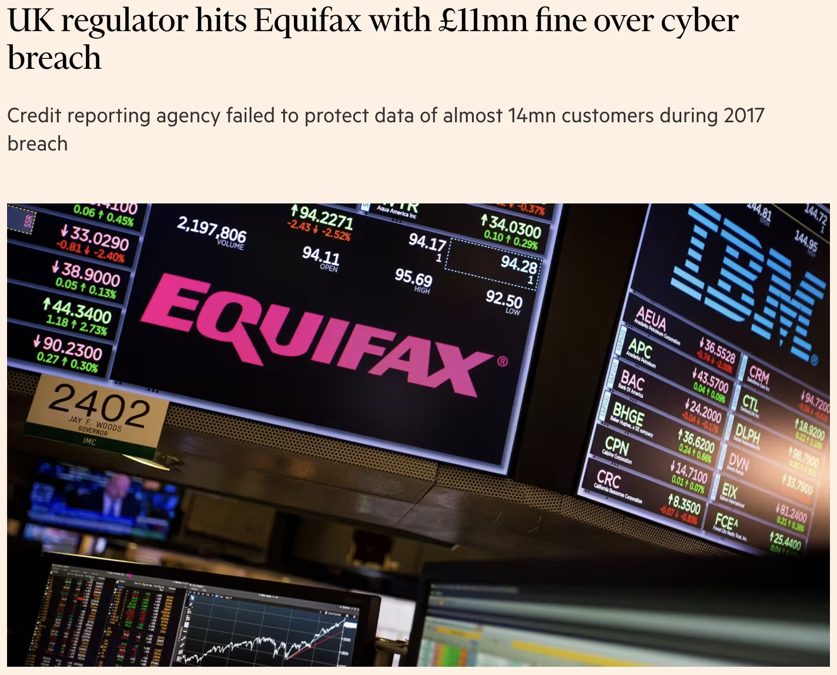
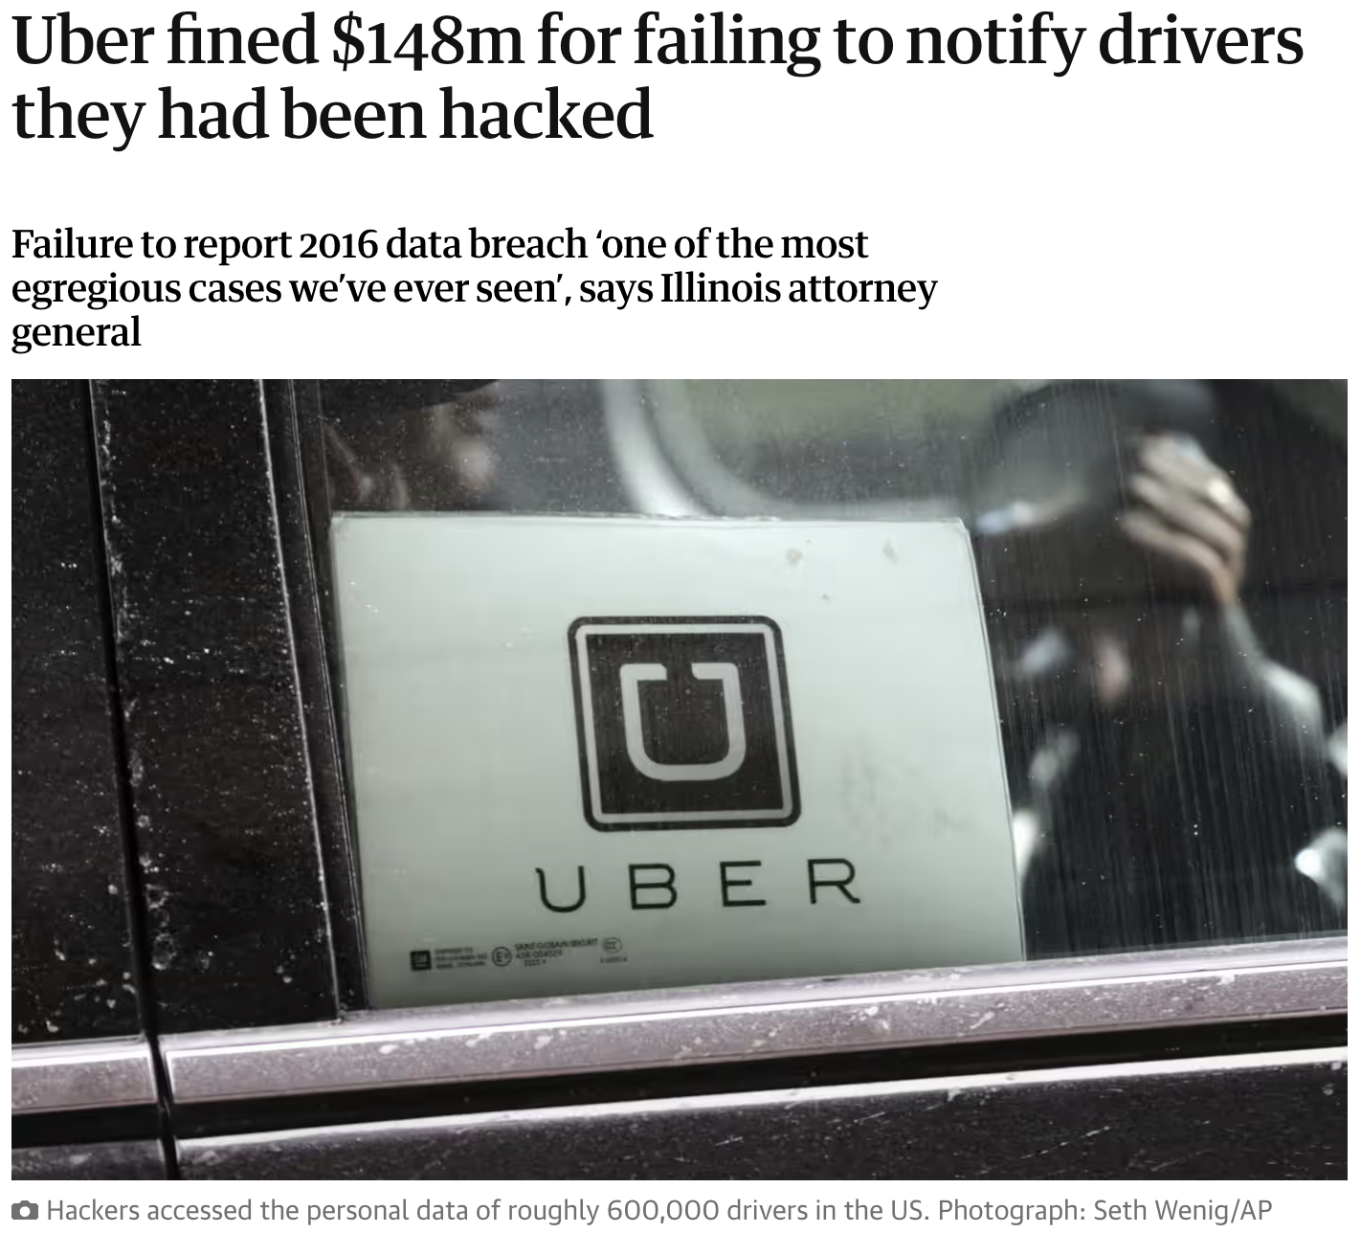
Common Security Vulnerabilities and Threats
Attacks can be Expensive

Slide 14
Security Best Practices and Coding Standards
The ”Big Three” Concepts in Network Security
Authentication
  Knowing with whom you are communicating
    User knowing the server and/or server knowing the user
      Which is more important??
Authorization
  User having privilege to perform an operation on server
Confidentiality
  Communicating without others knowing what’s been said
  Intermediaries cannot change what was said
  Typically includes protection from replay attack
    (Typically does *not* provide secrecy of communication. Others can know communication occurred)

Slide 15
Security Best Practices and Coding Standards
Concepts every Software Engineer need to Know
One-way Hashing
Secret Key Encryption
Public Key Encryption
Certificates

Slide 16
Security Best Practices and Coding Standards
Hashing (aka Message Digests, One-Way Hashing)
A hash function is a one-way encoding of data
  Same input, same output
  Different output, different input
Easy (relatively) to compute the hash function
Hard to compute the hash function’s inverse
We only store hashed passwords on disk
  To prevent passwords from being compromised if our servers are broken into

Slide 17
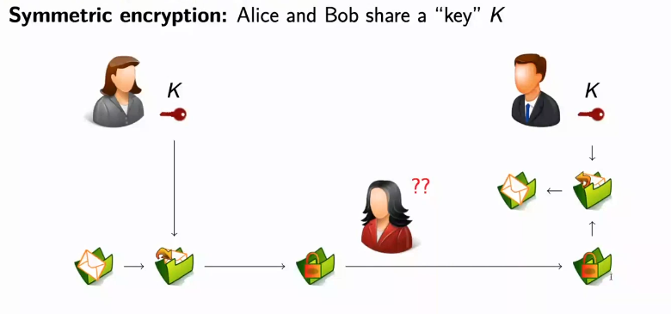
Security Best Practices and Coding Standards
Secret Key Cryptography (aka Symmetric, Private key Crypto)
Like in the old movies and spy books
One key (K)
  Shared Secret
  Used to encrypt and decrypt
  Notation: {data}K

Slide 18
Security Best Practices and Coding Standards
Public Key Cryptography (aka Asymmetric key Crypto)
Key Pair (key 1 & key 2)
  Either key can be used to encrypt (key 1 or key 2)
  You can only decrypt using the “other key” (key 2 or key 1)
  One key is given out (the public key)
  The other key is kept secret (the private key)
  Notation: For entity X, we have keys X_{pub} & X_{priv}
A public key can be given out freely to
  Encrypt data sent to the holder (X) of the private key
    Notation: {data}X_{pub}

Slide 19
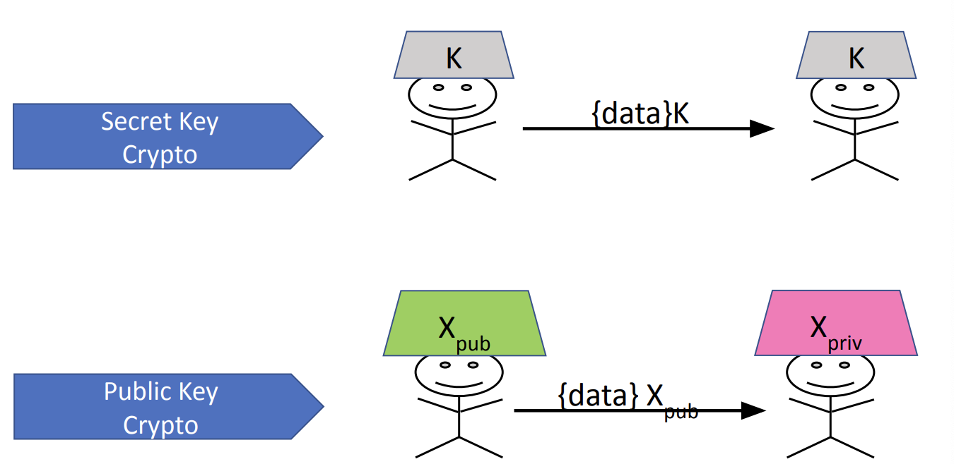
Security Best Practices and Coding Standards
Public Key Cryptography (aka Asymmetric key Crypto)

Slide 20
Security Best Practices and Coding Standards
Certificate Authority
A Certificate Authority (CA) confirms an entity’s public key
  Usually this will be a server’s public key
Companies get paid to do this
  They “check out” the requestor
    Now-a-days domain registrars provide this service
  They issue a “certificate” with the information
  Certificates are signed with the CA’s private key
CA’s public key is “well-known”
  It’s in an additional certificate
  Pre-installed or added to your configuration

Slide 21
Security Best Practices and Coding Standards
Best Practices for Secure Coding
Input Validation: Sanitize and validate all user input to prevent injection attacks.
Use of Secure APIs: Use APIs that avoid common vulnerabilities, such as secure libraries for encryption.
Error Handling: Avoid exposing system information through error messages.
Principle of Least Privilege: Restrict access rights to the minimum necessary.
Regular Code Reviews: Conduct peer reviews focusing on security to detect vulnerabilities early.

Slide 22
Security Best Practices and Coding Standards
Coding Standards
Adopting standardized secure coding practices, such as CERT Secure Coding Standards for languages like Java and C++.
Examples: Avoiding hardcoded secrets, using prepared statements, and handling user inputs securely.

Slide 23
Implementing Security Testing in the Development Process
Types of Security Testing
Static Analysis: Examines code for security flaws without executing it (e.g., SonarQube).
Dynamic Analysis: Tests running applications to identify vulnerabilities (e.g., Burp Suite).
Penetration Testing: Simulates real-world attacks to identify weak points.
Fuzz Testing: Sends random data to the application to find security loopholes.

Slide 24
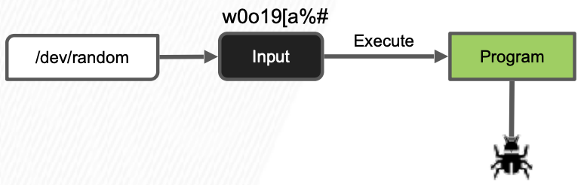
Fuzz Testing
Security and Robustness
A 1990 study found crashes in: adb, as, bc, cb, col, diction, emacs, eqn, ftp, indent, lex, look, m4, make, nroff, plot, prolog, ptx, refer!, spell, style, tsort, uniq, vgrind, vi

Slide 25
Fuzz Testing
Common fuzzer-found Bugs in C/C++
Causes: incorrect arg validation, incorrect type casting, executing untrusted code, etc.
Effects: buffer-overflows, memory leak, division-by-zero, use-after-free, assertion violation, etc. (“crash”)
Impact: security, reliability, performance, correctness

Slide 26
How do you make programs “Crash” when a Bug is Encountered?

Slide 27
Fuzz Testing
Automatic Oracles: Sanitizers
Address Sanitizer (ASAN) ***
LeakSanitizer (comes with ASAN)
Thread Sanitizer (TSAN)
Undefined-behavior Sanitizer (UBSAN)

Slide 28
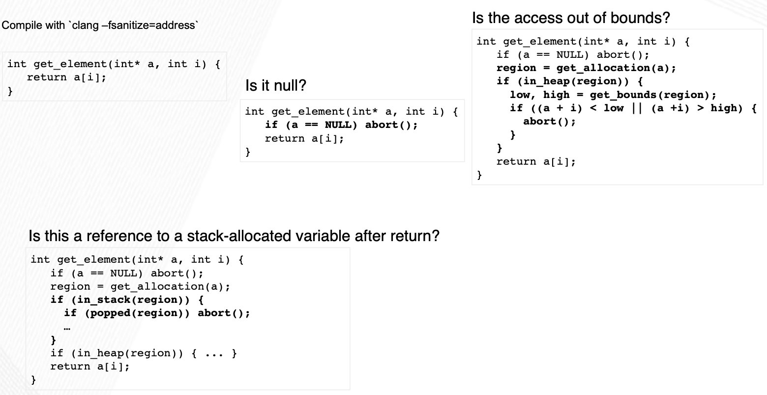
Sanitizers
AddressSanitizer

Slide 29
Sanitizers
AddressSanitizer
Asan is a memory error detector for C/C++. It finds:
  Use after free (dangling pointer dereference)
  Heap buffer overflow
  Stack buffer overflow
  Global buffer overflow
  Use after return
  Use after scope
  Initialization order bugs
  Memory leaks

Slide 30
Sanitizers
Strengths and Limitations
Strengths:
  Cheap to generate inputs
  Easy to debug when a failure is identified
Limitations:
  Randomly generated inputs don’t make sense most of the time.
    E.g. Imagine testing a browser and providing some ”input” HTML randomly: dgsad5135o gsd;gj lsdkg3125j@!T%#( W+123sd asf j
    Unlikely to exercise interesting behavior in the web browser
    Can take a long time to find bugs. Not sure when to stop.

Slide 31
Testing performance
Performance Testing
Goal: Identify performance bugs. What are these?
  Unexpected bad performance on some subset of inputs
  Performance degradation over time
  Difference in performance across versions or platforms
Not as easy as functional testing. What’s the oracle?
  Fast = good, slow = bad // but what’s the threshold?
  How to get reliable measurements?
  How to debug where the issue lies?

Slide 32
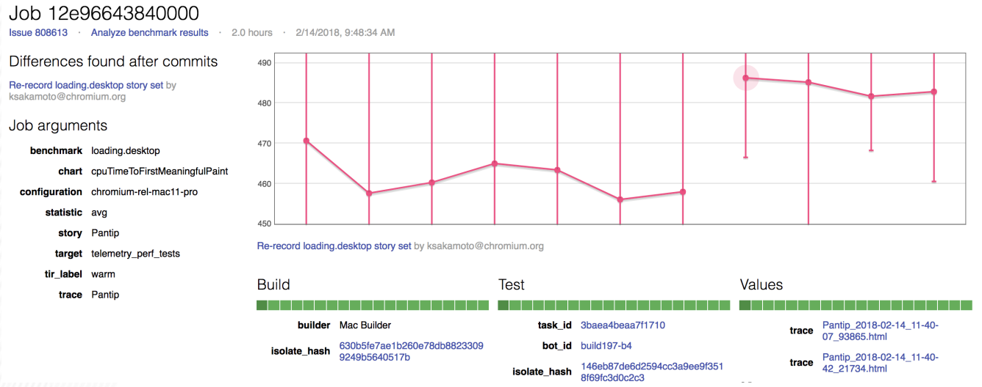
Testing performance
Performance Regression Testing
Measure execution time of critical components
Log execution times and compare over time

Slide 33
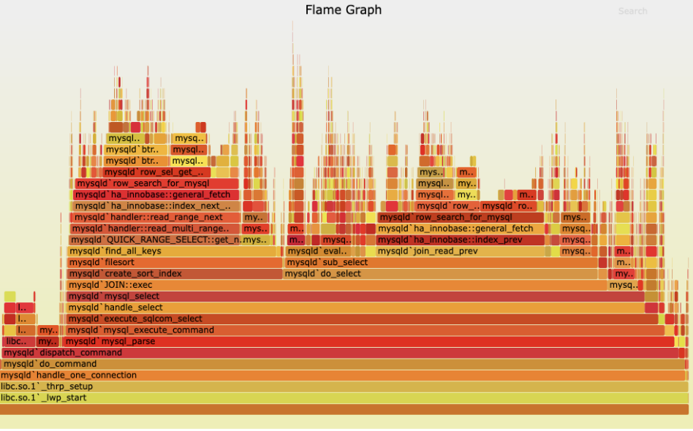
Testing performance
Profiling
Finding bottlenecks in execution time and memory
Flame graphs are a popular visualization of resource consumption by call stack.

Slide 34
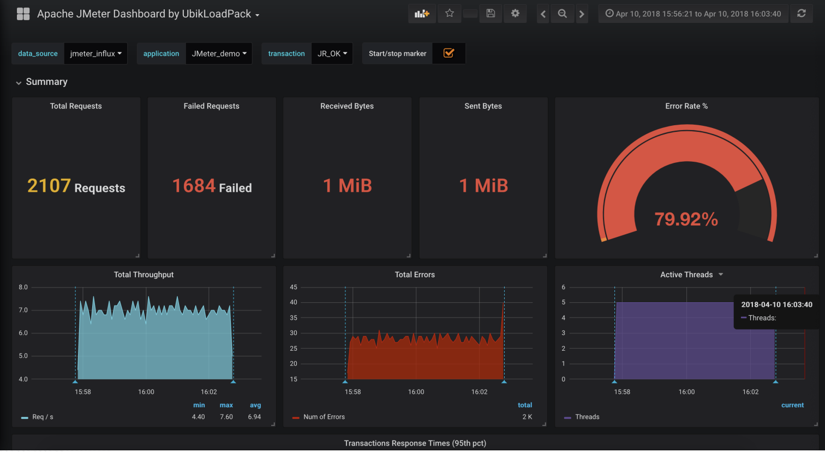
Testing performance
Domain-specific Perf Testing (e.g. Jmeter)

Slide 35
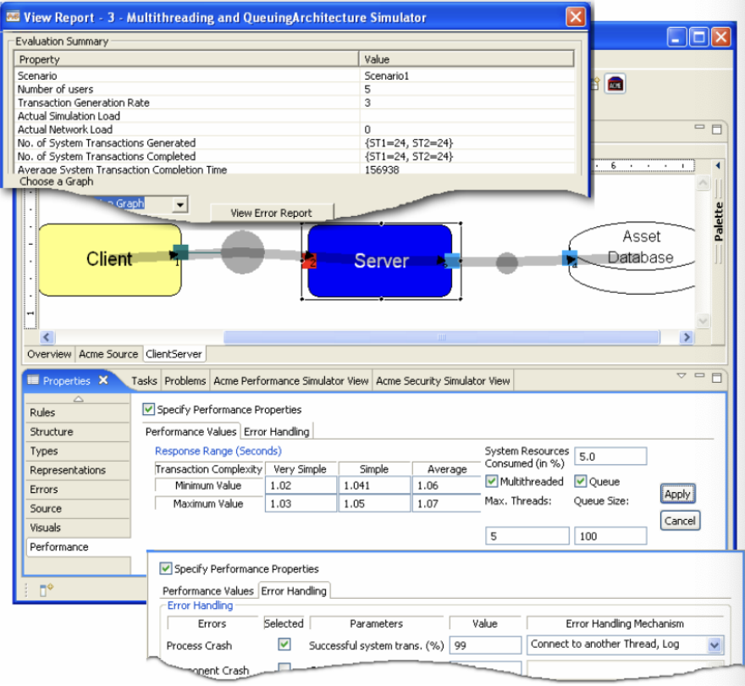
Testing performance
Performance-driven design
Modeling and simulation
  e.g. queuing theory
Specify load distributions and derive or test configurations

Slide 36
Testing performance
Stress Testing
Robustness testing technique: test beyond the limits of normal operation.
Can apply at any level of system granularity.
Stress tests commonly put a greater emphasis on robustness, availability, and error handling under a heavy load, than on what would be considered “correct” behavior under normal circumstances.

Slide 37
Testing performance
Soak Testing
Problem: A system may behave exactly as expected under artificially limited execution conditions.
  E.g., Memory leaks may take longer to lead to failure (also motivates static/dynamic analysis, but we’ll talk about that later).
Soak testing: testing a system with a significant load over a significant period of time (positive).
Used to check reaction of a subject under test under a possible simulated environment for a given duration and for a given threshold.

Slide 38
Testing performance
Where Do We Start?
How do we even begin to test these scenarios?
Is there any software that can be used to test these types of failures?
Let’s look at a few ways companies do this.

Slide 39
Implementing Security Testing in the Development Process
Integrating Security Testing into CI/CD
Automate security tests in CI/CD pipelines to ensure new code does not introduce vulnerabilities.
Example: A CI/CD pipeline integrates static analysis tools to check for security flaws with each commit.

Slide 40
Tools for Secure Software Development
Static Analysis Tools:
  SonarQube: Analyzes code for security vulnerabilities, code smells, and other issues.
  Checkmarx: Detects vulnerabilities in source code and provides remediation guidance.
Dynamic Analysis Tools:
  Burp Suite: Widely used for testing web application security, including XSS and SQL injection vulnerabilities.
  OWASP ZAP (Zed Attack Proxy): An open-source tool for finding vulnerabilities in web applications.
Dependency Management Tools:
  Snyk: Monitors dependencies for known vulnerabilities.
  Dependabot: Automatically updates dependencies with known vulnerabilities.
Example: Demonstrate how to scan a codebase using SonarQube and interpret the results to identify security risks.

Slide 41
Case Studies on Security Failures and Successes
Case Study on Security Failures
Equifax Data Breach:
  Due to an unpatched vulnerability in the Apache Struts framework, attackers gained access to sensitive data.
  Key Lessons: Importance of timely patching, regular security testing, and monitoring.

Slide 42
Case Studies on Security Failures and Successes
Case Study on Security Successes
Google's Bug Bounty Program:
  Google’s Vulnerability Reward Program incentivizes ethical hackers to find and report vulnerabilities.
  Key Lessons: Bug bounties and proactive security testing can prevent major breaches.

Slide 43
References
McGraw, G. (2021). Software Security: Building Security In (2nd ed.).
Viega, J., & McGraw, G. (2020). Building Secure Software: How to Avoid Security Problems the Right Way (3rd ed.).

